Slide 1
Hill Cipher
(Network Security)

Slide 2
Outline
Hill Cipher
Definition
History
Key Point
Key Table
Examples
Encryption
Decryption
Online Hill Cipher

Slide 3
Hill Cipher
Hill cipher is a polygraphic substitution cipher based on linear algebra.
Invented by Lester S. Hill in 1929, it was the first polygraphic cipher in which it was practical (though barely) to operate on more than three symbols at once.
In Hill Cipher Index of Ceaser Cipher is used.
Plain Text is used Column Matrix.
Key is given in Matrix Form.

Slide 4
Key Points
Each letter is represented by a number modulo 26.
Simple scheme A = 0, B = 1, ..., Z = 25 is used, but this is not an essential feature of the cipher.
To encrypt a message, each block of n letters (considered as an n-component vector) is multiplied by an invertible n × n matrix, against modulus 26.
To decrypt the message, each block is multiplied by the inverse of the matrix used for encryption.
The matrix used for encryption is the cipher key, and it should be chosen randomly from the set of invertible n × n matrices (modulo 26).

Slide 5
Key
0 | 1 | 2 | 3 | 4 | 5
A | B | C | D | E | F
6 | 7 | 8 | 9 | 10 | 11
G | H | I | J | K | L
12 | 13 | 14 | 15 | 16 | 17
M | N | O | P | Q | R
18 | 19 | 20 | 21 | 22 | 23
S | T | U | V | W | X
 |  | 24 | 25
 |  | Y | Z

Slide 6
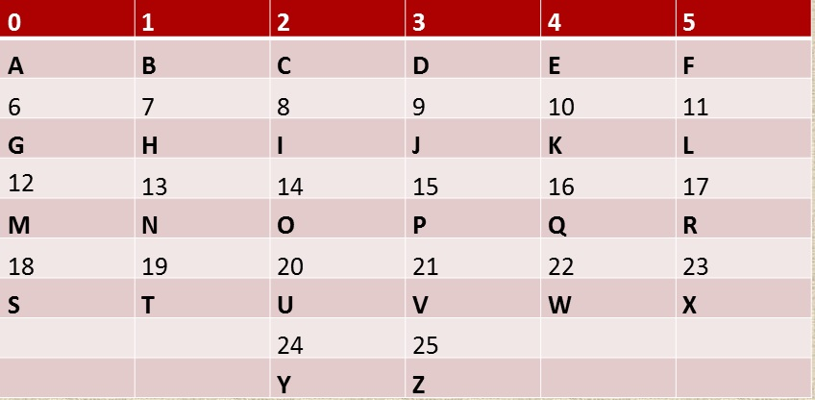
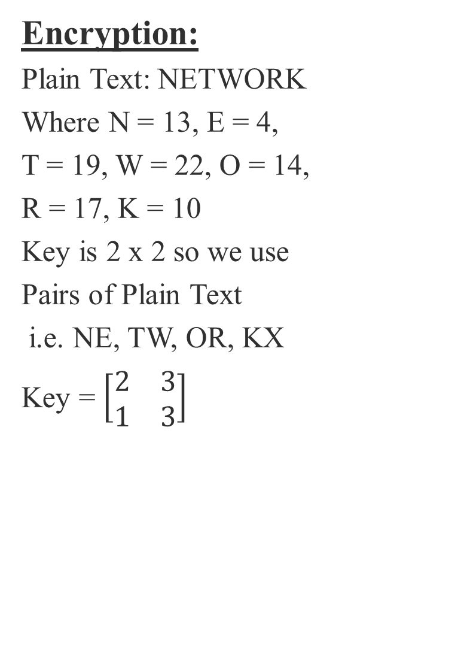
Example
Encryption:
Plain Text: NETWORK
Where N = 13, E = 4,
T = 19, W = 22, O = 14,
R = 17, K = 10
Key is 2 x 2 so we use
Pairs of Plain Text
i.e. NE, TW, OR, KX
Key = $\left[\begin{matrix}2 & 3 \\ 1 & 3\end{matrix}\right]$

Slide 7
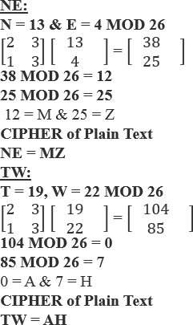

Slide 8
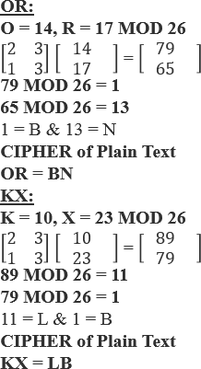

Slide 9
Encryption Complete
PLAIN TEXT: NE TW OR KX
CIPHER TEXT:MZ AH BN LB

Slide 10
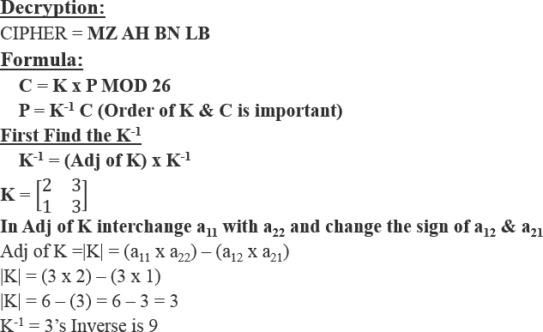
Decryption start

Slide 11
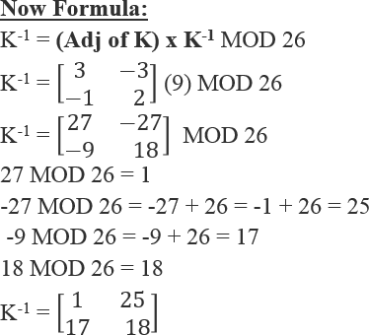

Slide 12
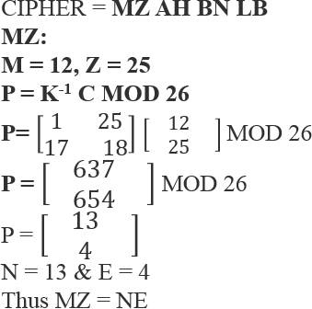

Slide 13
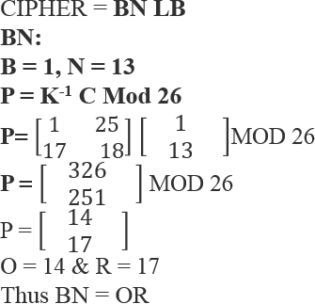

Slide 14
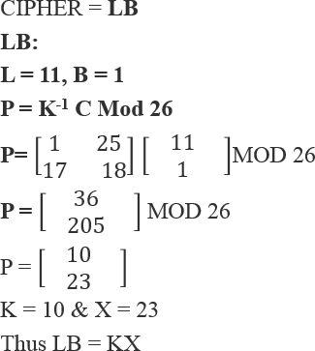

Slide 15
DECRYPTION COMPLETE
MZAHBNLB
NETWORKX

